Slide 1
Building Climate Resilience for Health through the UCHAI Network
John M. Balbus, MD, MPH
Senior Advisor for Public Health
National Institute of Environmental Health Sciences
U.S.-India Partnership for Climate Resilience
Workshop on Development and Applications of Downscaling Climate Projections
IITM, Pune, India
March 7 – 9, 2017

Slide 2

The National Institute of Environmental Health Sciences
One of the 27 National Institutes of Health
  Located in Research Triangle Park, North Carolina
Wide variety of programs supporting our mission of environmental health:
  ‒ Intramural laboratories ‒ Clinical research program
  ‒ Extramural funding programs ‒ National Toxicology Program
  ‒ Disease Prevention ‒ Public Health Focus
Notes:
We at NIEHS are one of 27 institutes and centers of the National Institutes of Health, the only one not headquartered at the Bethesda, MD campus. Our campus and headquarters is located in Research Triangle Park, North Carolina.
We are the premier environmental health sciences research institution in the world, with both intramural laboratories and extramural funding programs. Like most of our sister NIH institutes, the greatest share of our funding goes to support our extramural research and training activities in universities and research institutions across the nation. We also provide the headquarters and leadership, and most of the funding, for the National Toxicology Program.
NIEHS is unique at the NIH because we are the only one whose research has a primary focus on preventing disease, rather than diagnosing and treating it. We do conduct clinical research as well, but we are different from the rest of NIH in our understanding of, and commitment to, prevention and public health.

Slide 3
Overview
Linkages between climate change and health: US as an analogy for India
What does building resilience look like?
  Two sides of climate-health adaptation coin
  Scale and skill
Introduction to Understanding Climate Health Associations in India (UCHAI) network
ew of the UCHAI Community of Practice

Slide 4
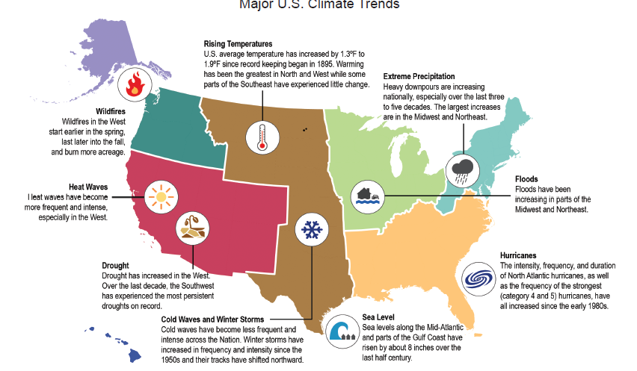
Major US Climate Trends
Climate and Health Assessment, 2016

Slide 5

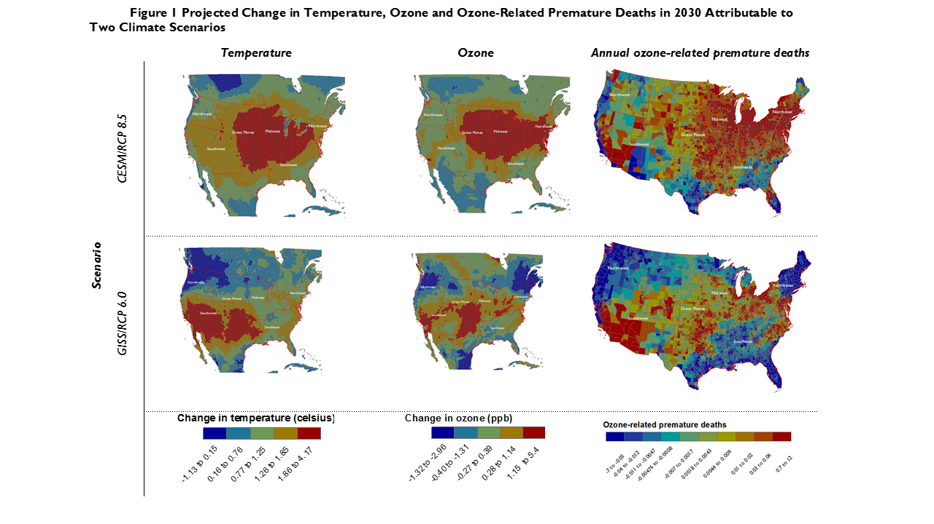
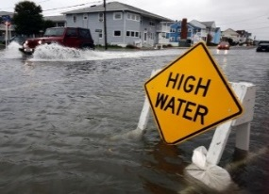
Significant Findings
  Quantifies future increases in temperature-related deaths
  Confirms very high confidence in association between hotter- and colder-than-normal temperature and increased illness and death
  Quantifies the increase of thousands to tens of thousands of premature heat-related deaths projected in the summer due to climate change
  Assesses the impact of changes in tolerance to extreme heat on future deaths from heat
  Confirms air quality impacts and provides likelihood for ozone, wildfire impacts
  Provides new likelihood assessment (likely) and high confidence that climate change will make it harder for any given regulatory approach to reduce ground-level ozone pollution, and that increased wildfires increase risk of premature death, adverse cardiovascular/respiratory outcomes
  Confirms high confidence that increases in airborne allergens will worsen allergy and asthma conditions and confirms indoor air health risks as significant emerging area
  Connects changes in extreme events to increased exposure to health impacts
  Describes health impacts to extreme events with high confidence, including death, injury, or illness; exacerbation of underlying medical conditions; and adverse effects on mental health
  Identifies impacts to health from disruption of essential infrastructure
  High confidence that coastal flooding will impact vulnerable communities

Slide 6
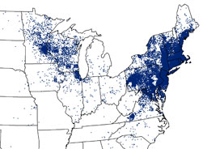
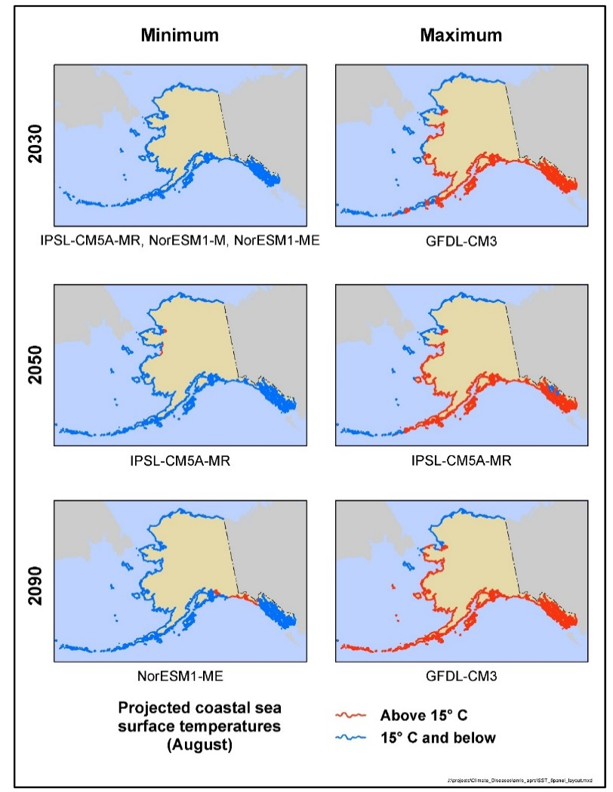

Significant Findings
  Provides likelihood of changing vector distribution, expands discussion of WNV
  Likely, high confidence in changing geographic and seasonal distribution of ticks carrying Lyme, and likely, medium confidence in increases in risk to human exposure
  Assessment of impacts of West Nile virus show very likely, high confidence in climate change influence on distribution, abundance, and prevalence of infection in mosquitoes
  Details sources and pathways (drinking, recreational) of waterborne illness risk
  Disaggregates confidence and likelihood for changes in multiple water-related illnesses from Vibrio bacteria, marine harmful algae, freshwater harmful algae, and runoff sources
  Describes health impacts of water infrastructure damage or failures
  First assessment of rising CO₂, climate on quality (nutritional value) of food
  Describes impacts of pathogens, toxins, and chemical contaminants in US food chain
  Assesses the large body of research establishing very likely, high confidence that nutritional value of food crops, such as wheat and rice, will decrease as rising levels of atmospheric CO₂ reduce concentrations of protein and essential minerals in most species

Slide 7


Significant Findings
  Presents an important emerging area: increased mental health consequences
  Confirms Very High Confidence in extreme weather and climate related impacts including post-traumatic stress disorder (PTSD), depression, and anxiety, often at the same time
  Introduces issue of mental health impacts from the real and perceived threats of climate change and risks of heat exposure to people with pre-existing mental health illnesses or prescription medications
  Details the ways in which climate change affects the health of us all
  People experience different inherent sensitivities to the impacts of climate change at different ages and life stages. For example, the findings confirm with very high confidence the very young and old are particularly sensitive to climate-related health impacts.

Slide 8
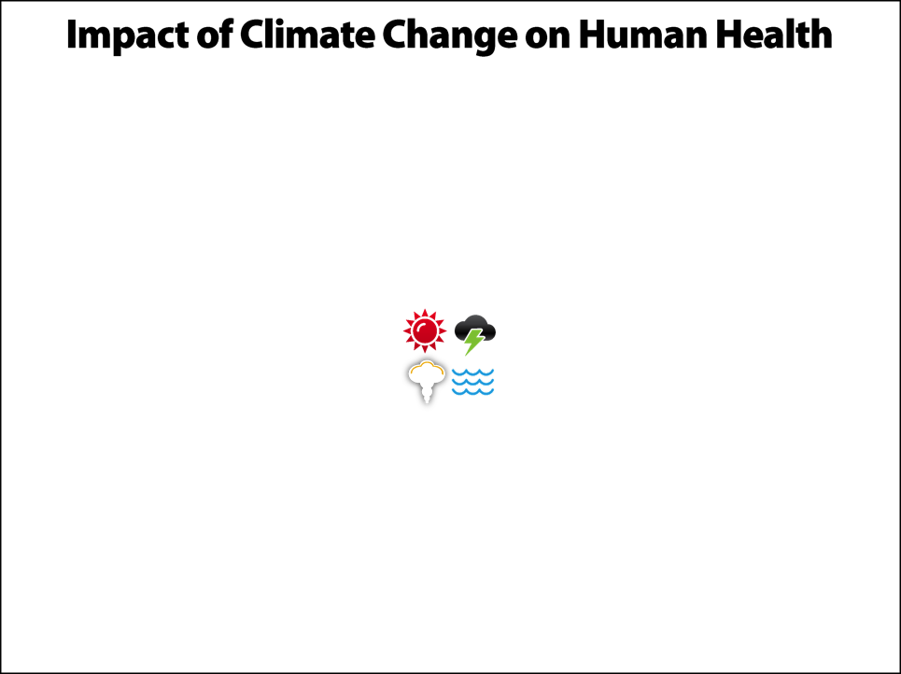
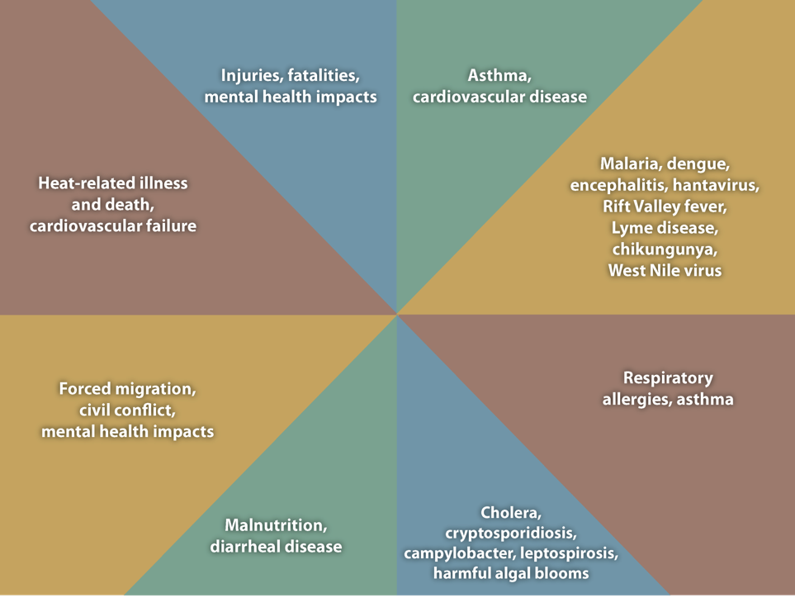
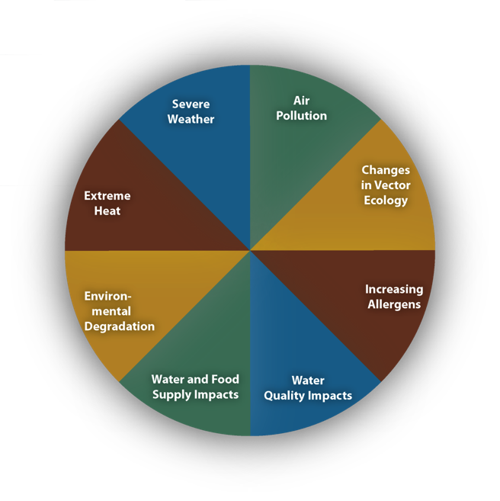
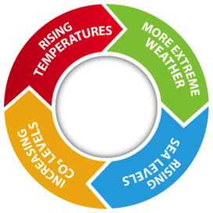
Slide courtesy of Dr. George Luber, CDC

Slide 9
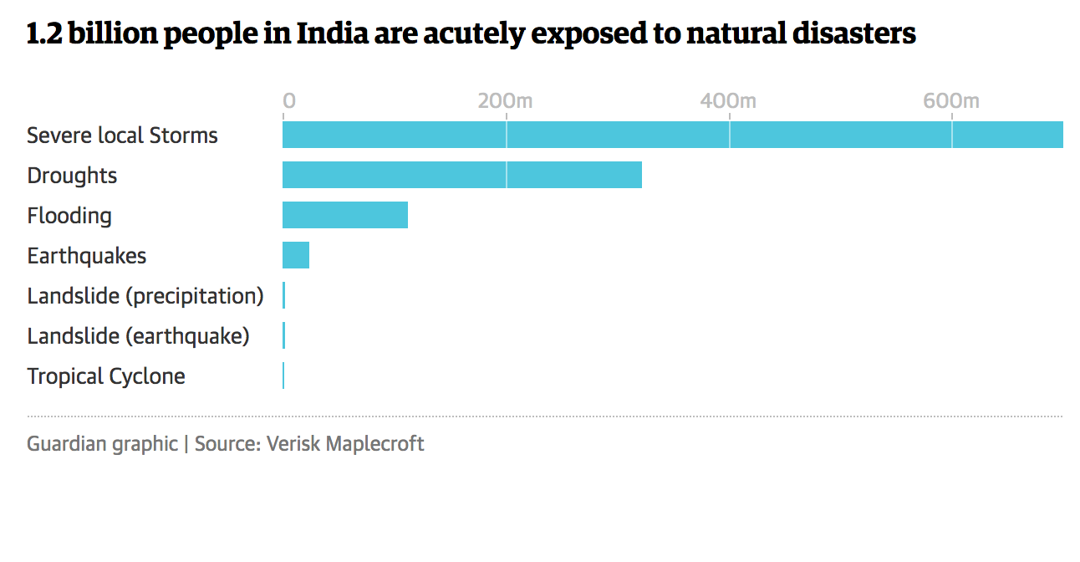
Climate Health Threats in India

Slide 10

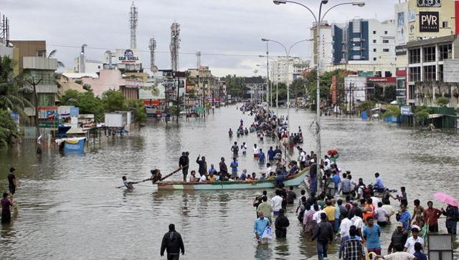
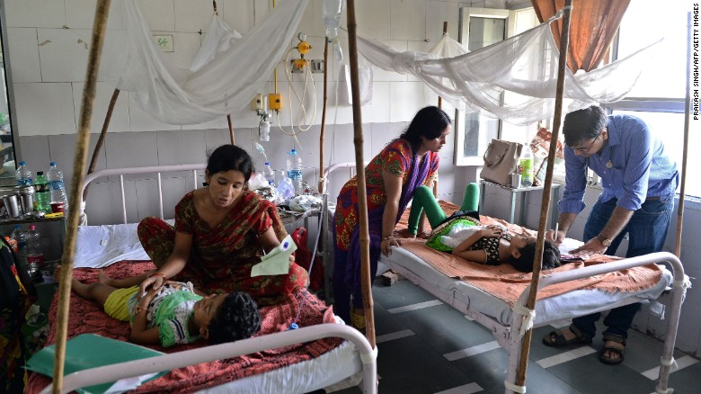
Climate, extremes and health in India

Slide 11
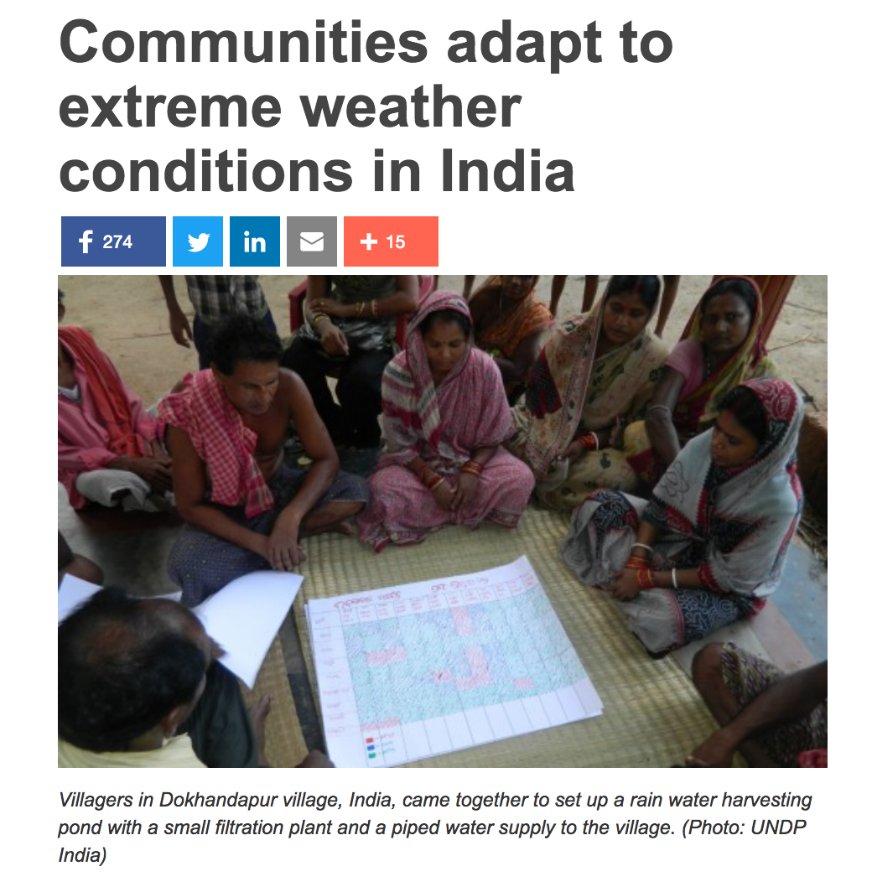

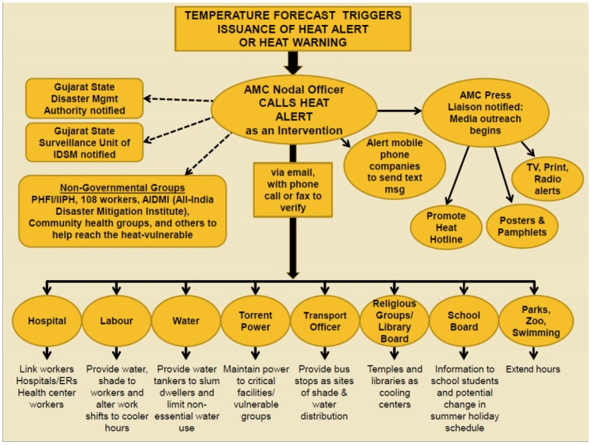
What does resilience look like?
Notes:
http://www.telegraph.co.uk/news/worldnews/asia/india/11636124/Indias-extreme-heat-wave-in-pictures.html?frame=3321137

Slide 12
The time scales of climate and health decisions
Emergency Response (minutes-hours)
  Severe storms
Short-term Forecasts (1-10 days)
  Weather/air warnings: Heat, air quality, pollen, severe storms
  Water quality, coastal water alerts
Medium-term Forecasts (seasonal-interannual)
  Infectious disease early warnings
  Weather-climate outlooks: heat, storms, precipitation
Long-term Forecasts (decadal)
  Infrastructure planning
  Health system long-term planning;

Slide 13
Seamless Forecast Products for Health
Years
Decades
Outlook
Seasons
Guidance
Months
Climate Prediction
Products (Probabilistic)
Threats Assessments
2 Week
Forecast Lead Time
1 Week
Forecasts
Days
Weather Prediction
Products (Deterministic)
Watches
Hours
Warnings & Alert Coordination
Minutes
Benefits
Emergency Response Plan Activation
Short term budget and priority planning
Budget and civic planning for long-term resources
Capital investments & capacity Planning
Urban Planning, design, and construction
Emergency management
Pre-positioning assets and
public alerts
Staffing and resource Planning
Vaccine planning

Slide 14
Elements of health system resilience I: Mainstreaming climate thinking into public health
Reducing health disparities; addressing basic public health needs
Physician and other health care provider training
  Recognition of imported or emerging infectious diseases
  Risk factors for heat illness
  Resilience- for providers too!
Anticipation of immigrant health issues
Health care facility resilience and hardening
Governance, coordination, training exercises

Slide 15
WHO Operational Framework, 2015

Slide 16
Elements of health system resilience II: Enhanced capacity for use of climate/weather information
Risk and vulnerability assessments
Visualization and mapping exercises
Early Warning Systems
  Partnership with Meteorological/Climate Services
Governance, coordination, training exercises
  Incorporation into climate adaptation planning

Slide 17
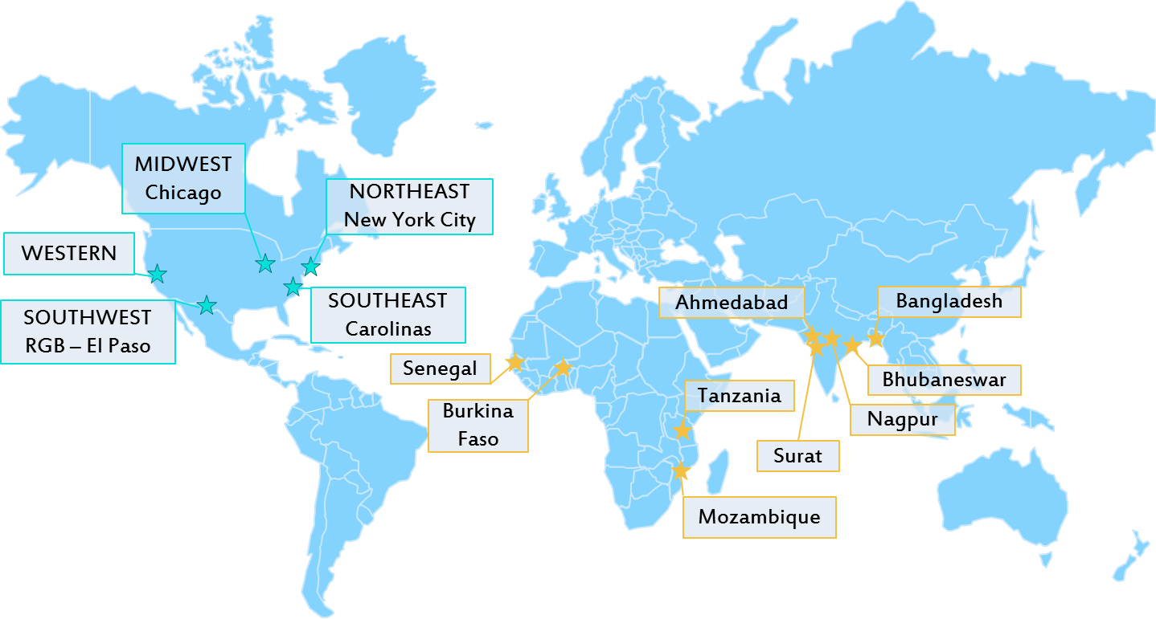
NIHHIS: US Pilots and International Network
The NIHHIS Network is composed of international knowledge-sharing partnerships and U.S. local pilots, but all address shared questions.
Notes:
SMALLER VERSION
Internationally, the NIHHIS network is active in India and Africa. Nascent partnerships in these areas are leading to improved understanding of approaches to heat health that can be shared in other countries including the US. We are eager to grow this network internationally, and SASCOF is one of many fora we hope to engage partners within. We hope that conversations started at SASCOF can grow this network.
Within the United States, engagements exist in many regions.
In the Southwest, the Rio Grande Bravo (RGB) pilot, which addresses the heat health risk of hot and arid climates along a rural to urban gradient, is centered in El Paso, Texas. It is designed to be trans-boundary – engaging communities on both sides of the US:Mexico border to reduce risk and share knowledge. This pilot is in the process of planning a workshop to flesh out the shared common questions from the NIHHIS framework - to develop them into structured and specific work streams with research questions and information products and services as outcomes.
The Northeast pilot is rapidly following the progress of the RGB pilot, and will also address urban issues such as the heat island effect in New York City and long term planning and design questions for such as city.
Additional pilots are in development in the Southeast, West, and Midwest.

Slide 18
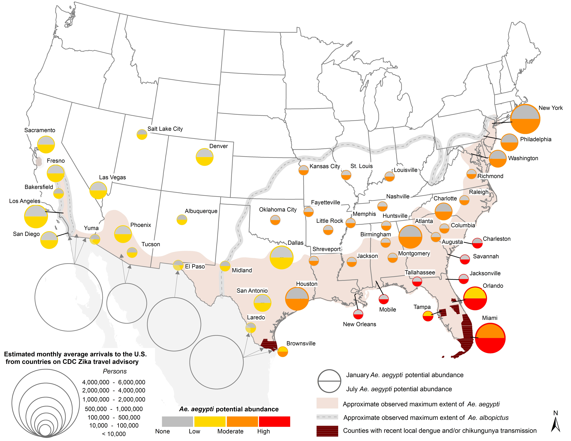
Zika risk mapping- importance of human travel

Slide 19
Opportunities and Challenges for Climate-Health Adaptation for India
OPPORTUNITIES
High level awareness of urgency of climate change action in policy makers
High and growing climate/meteorology capacity
Good weather/climate data availability
CHALLENGES
Relatively low priority on CC within the health sector
Low capacity for applying weather and climate information
Limited availability of health data

Slide 20
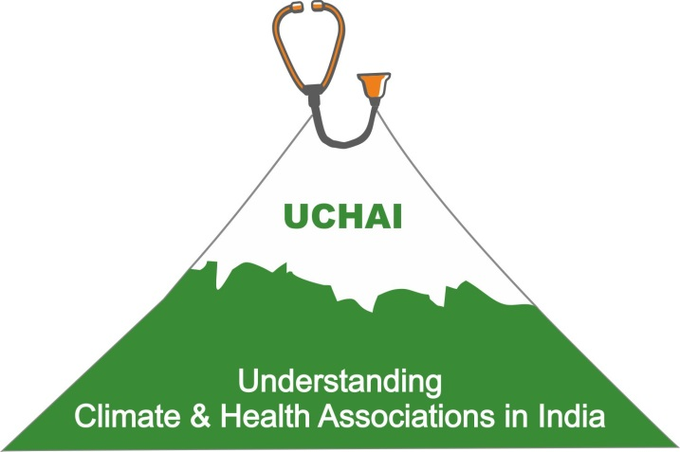
Understanding Climate and Health Associations in India Community of Practice
Vision of the UCHAI Community of Practice
India’s health sector has capacity to adapt to climate change and its health impacts.
Goals of the UCHAI Community of Practice
Training
  Train-the-trainer workshops, curriculum, training modules, Web portal
Research
  Extreme heat and weather events, climate-related diseases,
  vulnerable populations, capacity of the health systems etc.
Development of Tools
  Including Heat Action Plans, Predictive Models
Community Engagement
  Stakeholder/public participation to increase efficacy and
  impact of adaptation strategies.

Slide 21


Elements of the UCHAI Community

Slide 22
Conclusions
Momentum is building for strengthened public health systems and climate services for health
  Improved health monitoring and health information systems
  Improved meteorological records and short term forecasts
UCHAI provides one platform for sharing best practices and conducting training and capacity building
Partnership with meteorological community is foundational to providing data and tools and building capacity in the health sector in India

Slide 23


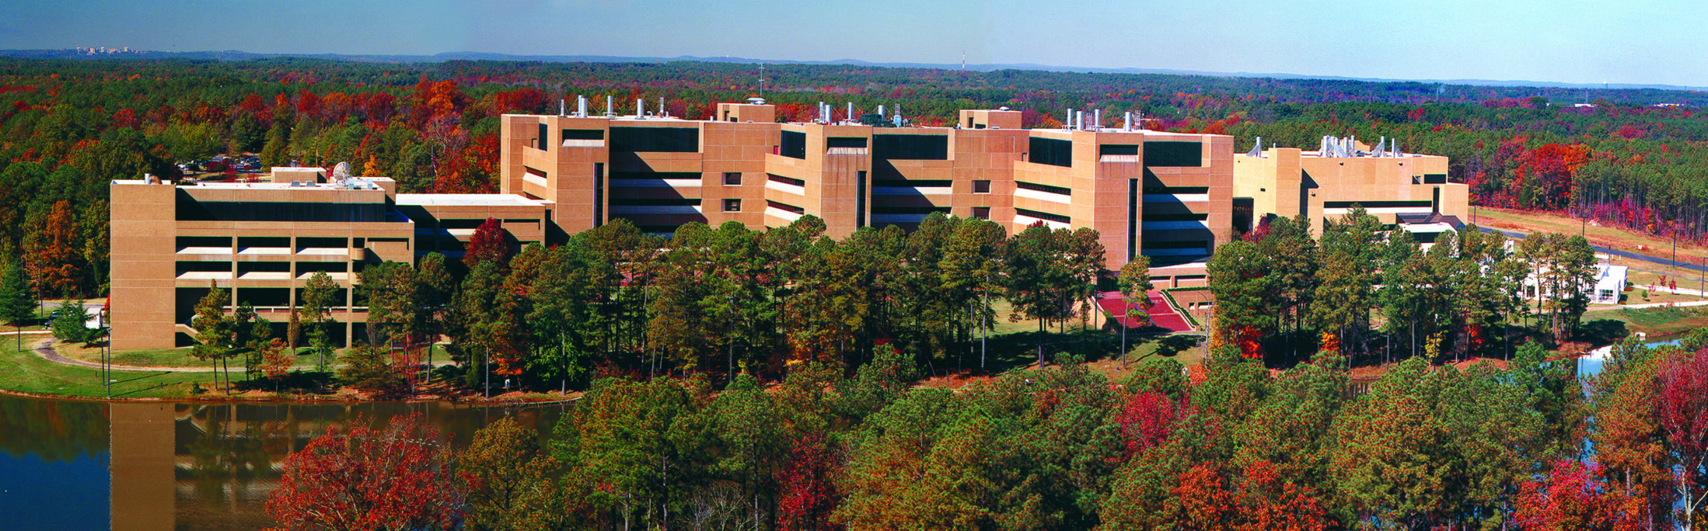
THANK YOU!
John M. Balbus, M.D., M.P.H.
John.balbus@nih.gov http://www.niehs.nih.gov/geh http://toolkit.climate.gov/

